Slide 1
Understanding and using the kit: Training of trainers for facilitators Module 1: Building adolescent circles
The Adolescent Development and Participation Section
Priya Marwah, Adolescents in Emergencies and Peacebuilding Specialist
Ellen Fransen, Programme Assistant
Juliet Young, Consultant

Slide 2
1.1 Introduction to the Adolescent Kit for Expression and Innovation: A toolbox of resources to support our programme
Notes:
Cover slide for this first section of the webinar.

Slide 3
What is the Adolescent Kit for Expression and Innovation?
It is a package of resources to support programmes for adolescents (children ages 10-18) during and after emergencies.
It is designed for use in child protection, education and/or youth development programmes and partnerships.
It reflects a cross-sectoral approach, integrating psychosocial support, life skills, adolescent participationand peacebuilding principles, goals and methods.
The Adolescent Kit includes:
Guidance for facilitators to lead activity cycles with and for adolescents
Guidance for programme coordinators to plan, support and oversee programmes for adolescents
Supplies to make the activities more feasible, engaging and rewarding
Notes:
Notes for the trainer:
Read this slide aloud to provide workshop participants with an overview of the resources in the Adolescent Kit for Expression and Innovation.
Subsequent slides provide more information and details of the contents and purpose of the resources.

Slide 4
UNICEF created this kit because…
Adolescents (people ages 10-19) are a key age group affected by conflict, disasters and other humanitarian crises;
Most adolescents – those who are ages 10-17 - are children within UNICEF’s mandate as custodians of the Convention on the Rights of the Child;
Adolescents are at risk of violations of their rights, including the risk that they do not have a chance to learn and grow to their full potential; and
Adolescents have the ability and the will to make positive contributions to humanitarian response programmes and to restore and build their communities.
Notes:
Notes for the trainer:
Read this slide aloud to anchor workshop participants’ attention in the situation and condition of the adolescents with whom they will be working.

Slide 5
… Yet UNICEF and partners often struggle to support this key age group with programmes and interventions that…
are appropriate to adolescents’ developmental needs and abilities;
reach and address the adolescents who are most in need and most marginalised (e.g. those with disabilities, those who are married, those from minority groups);
reflect and address adolescents’ own interests and priorities; and
apply best practices from all of our technical knowledge in psychosocial support, life skills education, and positive engagement.
Notes:
Notes for the trainer:
Read this slide aloud.
Give participants time to read and review Foundation Guidance, Why a kit for adolescents?
Ref: Foundation Guidance, Why a kit for adolescents?

Slide 6
What is in the Adolescent Kit for Expression and Innovation?
The Adolescent Kit for Expression and Innovation includes:
Guidance and tools for facilitators who are working directly with adolescents and facilitating activities
Guidance and tools for programme coordinators who design, manage and oversee programmes and interventions for adolescents
A Supply Kit with carrying cases, materials and supplies to make activities for adolescents more feasible and engaging, especially in low-resource environments
Notes:
Inform participants that the Foundation Guidance is intended for all users, and both facilitators and programme coordinators are encouraged to read and use that section, along with the guidance materials specifically addressed to their roles.
All guidance and tools are available electronically on the Adolescent Kit website (www.adolescentkit.org) and on the flash drive that is included in the supply kit. An abbreviated version of the guidance materials and tools is also included in print format in the Supply Kit.
The Glossary in the Foundation Guidance provides definitions of various terms used throughout the Adolescent Kit, including:
Facilitator: A trained professional or volunteer who works directly with a group of adolescents to facilitate activities and run sessions; related terms: teachers, coaches or animators
Programme coordinator: A general term to describe a staff member who has a key role in designing, managing or running a programme or intervention that uses the activities, tools and guidance in the Adolescent Kit; includes programme managers, programme officers, technical specialists or other staff within UNICEF or partner organisations
Ref: Foundation Guidance; Glossary

Slide 7
What is in the Kit? (continued)
Clarification of terms used to describe the resources in the Kit:
Guidance: Explanation of ‘how to’ plan, facilitate, monitor, and work with adolescents (These are included in print and electronic format)
Tools: Diagrams, checklists, and other materials (Also included in print and electronic format)
Supplies: Physical materials facilitators and adolescents use during their activities (such as paper, pens, marker boards, floor mats, etc.) These include reusable supplies (such as the marker board) and those that are not reusable (such as paper, tape and glue).
Notes:
Notes for trainer:
Read this slide aloud, or ask a workshop participant to do so.

Slide 8
Guidance and Tools
Guidance and tools for facilitators and programme coordinators in the Adolescent Kit are designed to be used flexibly along with other materials that may already be available or in use in programmes for adolescents.
Choose and adapt the guidance and tools that are most relevant the situation and needs of adolescents in your context to start a new programme or strengthen an ongoing programme.
Discussion:
What other guidance and tools are we already using in our programme(s) for adolescents?
Notes:
Notes for trainer:
Read this slide aloud, or ask a workshop participant to read it aloud.
This step offers an opportunity to integrate a discussion of how the Adolescent Kit will be used together with other programme materials, such as curricula or activity guides.

Slide 9
The Supply Kit, and Guide
The Supply Kit is intended especially for places where programmes are starting for the first time, and for places that are remote and hard to reach.
You don’t have to have the Supply Kit to use the guidance and tools. Most of the activities in the guidance don’t require any supplies.
Notes:
Notes for trainer:
Read this slide aloud or ask a workshop participant to do so.
Optional: Discuss supplies and materials workshop participants already have, or can procure, in addition to those provided in the Supply Kit.

Slide 10
The Supply Kit, and Guide
If you are using the Supply Kit, use the supplies included along with things you buy and make locally.
Supplies in the kit were chosen so that you can easily replace them.
Build on the positive by encouraging adolescents to find and use the resources around them. Recognize their potential to be creative even in challenging conditions.
Build on the positive
Notes:
Notes for trainer:
Read this slide aloud, or ask a workshop participant to do so.

Slide 11
1.2 Adolescents in humanitarian contexts

Slide 12
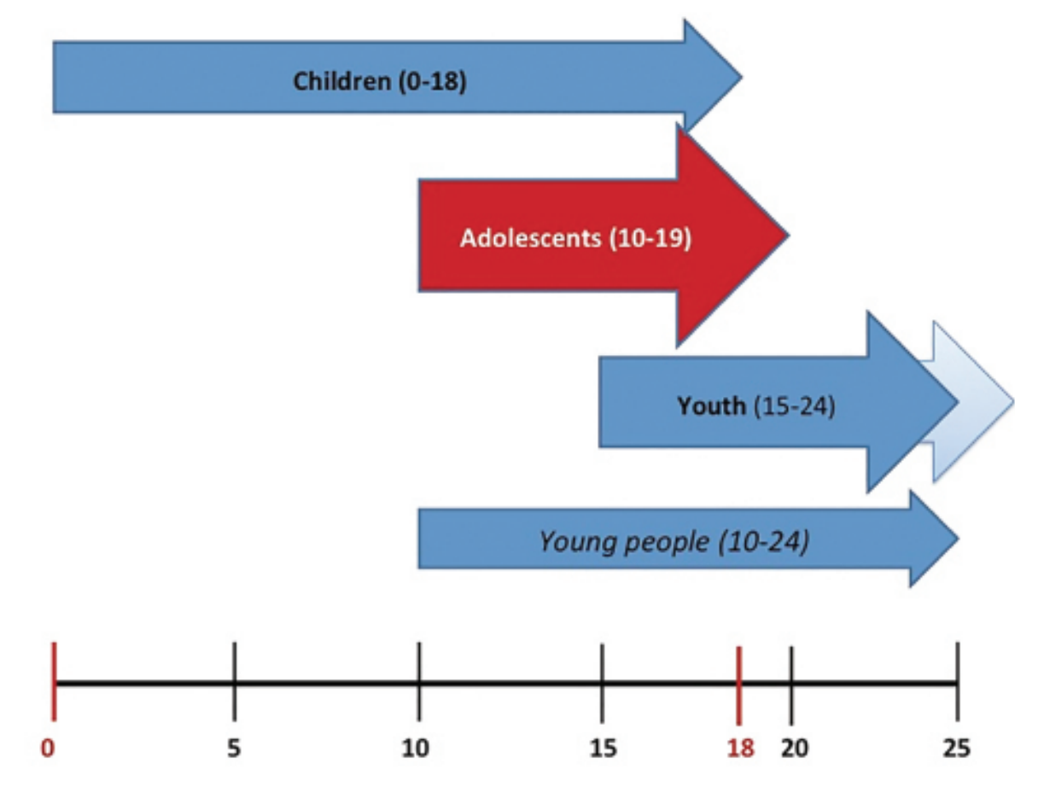
Notes:
Note for trainers:
This slide provides official definitions as follows:
Children are ‘human beings up to age 18’ as defined by the Convention on the Rights of the Child.
United Nations agencies, including UNICEF and UNFPA, use a working definition of ‘youth’ as human beings ages 15-24, but individual states utilize their own official definitions of ‘youth,’ which sometimes extend to higher age ranges.
‘Young people’ are defined by the United Nations as people ages 10-24.
UNICEF defines ‘adolescents’ as human beings ages 10-19.
The Adolescent Kit for Expression and Innovation is designed to support programmes and interventions for adolescents ages 10-17 – the subgroup of adolescents that are also children within UNICEF’s mandate. Depending on the individual context and goals, programme coordinators, facilitators, and anyone else using the Adolescent Kit may also choose to reach out to and include younger children and older adolescents or youth, adapting the approaches as they see fit for those populations.

Slide 13
Discussion:
How do the global patterns in issues facing adolescent in humanitarian contexts compare to the circumstances of adolescents in our programming context?

Slide 14
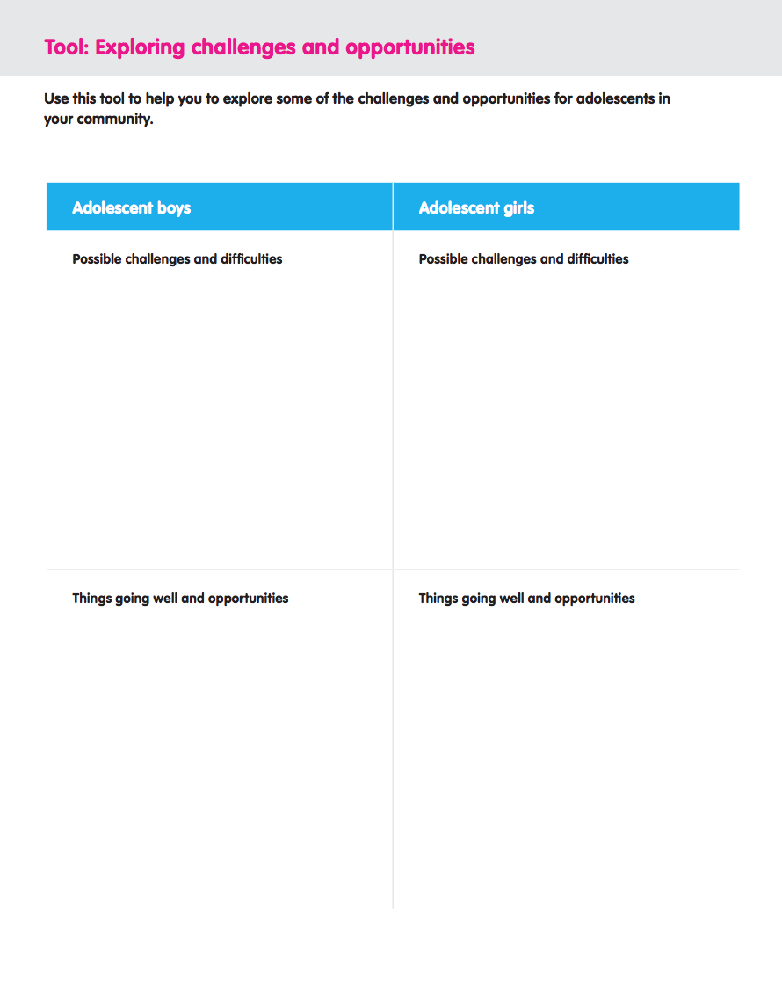
Discussion:
What are some of the key challenges and opportunities facing adolescent girls and boys ages 1—17 in our programming context?
Programme Coordinators’ Guide; Investigate Adolescents’ Situation
Notes:
Notes for trainer:
Participants should begin this step by reviewing Foundation Guidance: Understanding Adolescent in Humanitarian Contexts. The guidance can either be read aloud or participants can read it individually to themselves.
Participants should then compare the issues outlined in that guidance note to the challenges and opportunities they identified in the previous step of the training.
Participants may use the Exploring challenges and opportunities tool in the Programme Coordinators’ Guidance, Investigate Adolescents’ Situation section.
Ref: Foundation Guidance, Understanding adolescents in humanitarian contexts
Ref: Programme Coordinators’ Guidance, Investigate Adolescents’ Situation section, Tool: Exploring challenges and opportunities.

Slide 15
Discussion:
What are some of our knowledge gaps with respect to adolescents ages 10-17 in our programming context?
Which adolescents ages 10-17 are less visible in our context?
What should we learn more about adolescents’ situations in our context as we plan programmes to reach and engage them?
Reach out to all adolescents
Notes:
Note for trainer:
Use these questions to summarize and synthesise the issues raised in the previous step.
Explain to participants that in future modules of this training they will develop strategies to gather more information about adolescents in their programming context and use that information to strengthen their programmes’ outreach to and engagement of adolescents, especially those facing barriers to participation.
Refer participants to Programme Coordinators’ Guidance: Investigate adolescents’ situation for guidance and tools they use for that purpose.
Keep notes from this discussion for reference in future modules.

Slide 16
1.3 Ten key competencies for adolescents:
The purpose of the Adolescent Kit for Expression and Innovation

Slide 17
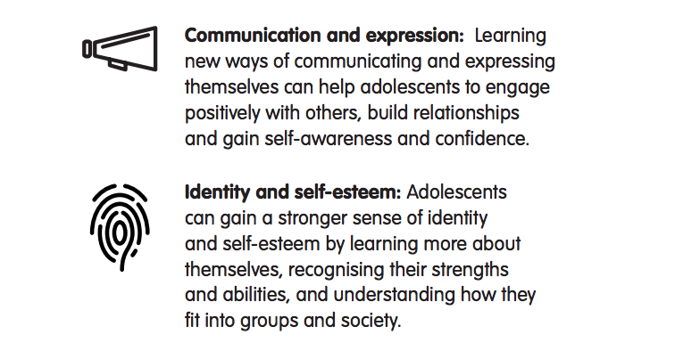
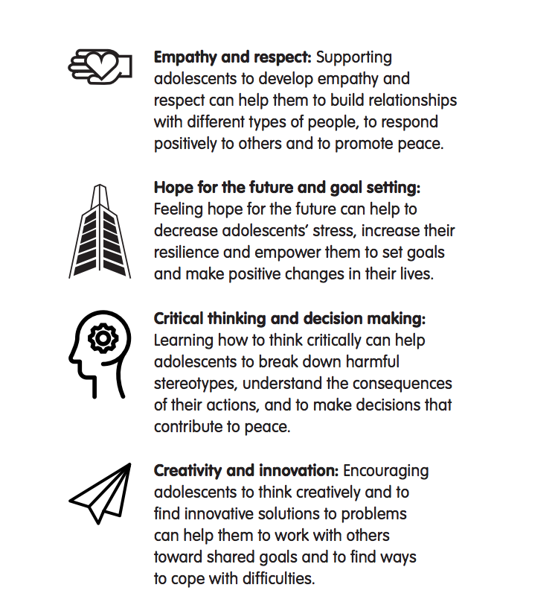
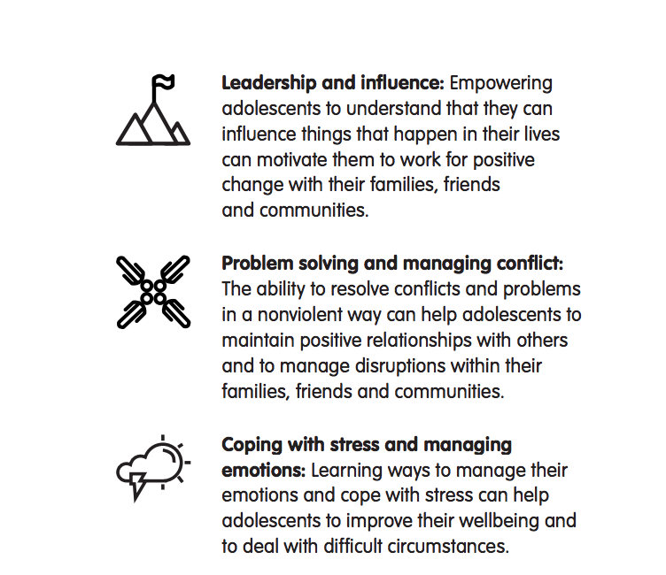
The Ten Key Competencies
Notes:
Notes for trainer:
Give a brief introduction to the competency domains and display image of the 10 competency domains.
Clarify that a ‘competency domain’ is a broad category of specific competencies - knowledge, attitudes, or skills that a person can put to use.
Provide time for discussion. Workshop participants can provide their own definitions or explanations of each competency domain, examples of specific areas of knowledge, skills or attitudes within each domain, and ask questions.
Ref: Foundation Guidance, The Ten Key Competencies for Adolescents (When available: Peacebuilding competency domain framework)

Slide 18
Group Work:
What terms are used to describe this competency in the local language?
Write words or phrases.
What does an adolescent who has developed this competency look like?
Draw a picture of an adolescent girl or boy who has developed this competency well.
Notes:
Notes for trainer:
Assign one competency domain to a pair (or small group) of workshop participants.
Distribute chart paper to each group.
Explain that each small group will respond to the questions on the slide. Their presentation should include:
Words or phrases for how the domain is explained in local language(s) (as relevant)
A drawing of an adolescent boy or girl who has developed this competency. (Suggest: If they wish, they can write explanatory notes on their drawing. They can also consider drawing a picture that shows the adolescent boy or girl using the competency.)
Have each group give their presentation. Allow time for questions and facilitate discussion .

Slide 19
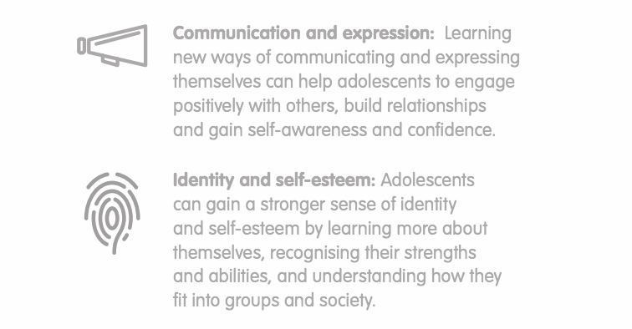
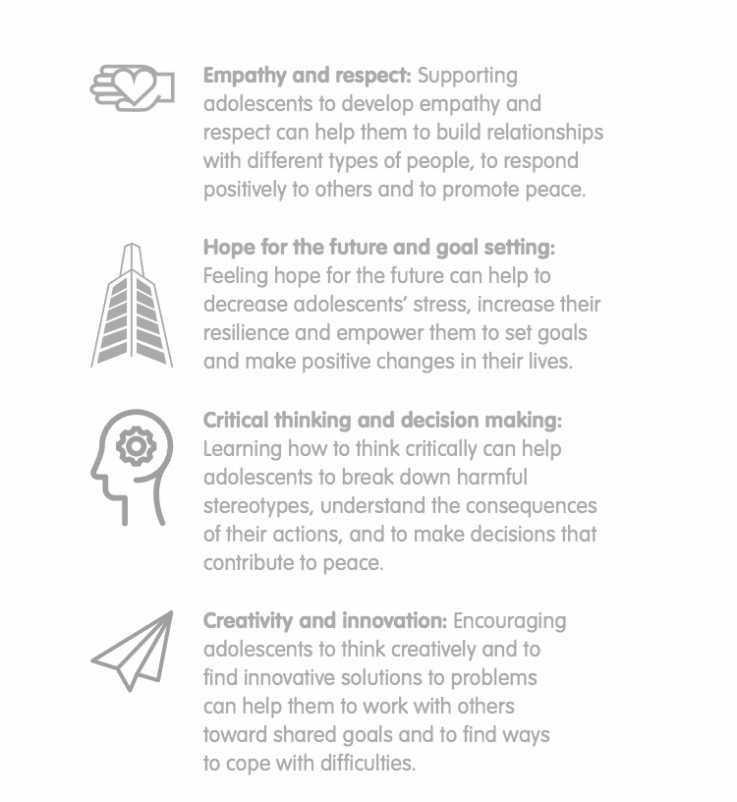
Group Work (continued):
In what ways do we see adolescents in our programme context already developing and using and using competencies in this domain?
In what ways could developing and using competencies in this domain enable adolescents to overcome the challenges or take advantage of the opportunities they face? (See notes from session 1.2)
If adolescents have the opportunity to fully develop and use competencies in this domain, what further positive changes can they make in their own lives?
If adolescents can fully develop and use competencies in this domain, what further positive changes can they make in their community?
Notes:
Notes for trainer:
Workshop participants should continue to work in the same small groups as in previous steps in this session, and should focus on the same competency they had been exploring.
If participants need to see the list of all ten competencies to continue their group work, turn back to Slide 18 and/or encourage them to refer to the Foundation Guide, Ten Key Competencies

Slide 20
Competency Domain:
1. We see adolescent girls and or boys using competencies in this domain when…
2. If adolescent girls and boys have more opportunities to develop and use this competency, they can overcome challenges or take advantage of opportunities in their lives by…
3. If adolescent girls and boys fully develop and use this competency they can make positive changes in their lives by…
4. If adolescent girls and boys fully develop and use this competency they can make positive changes in their communities by…
Notes:
Notes for trainer:
Distribute a piece of chart paper to each small group. Ask participants to draw the matrix and fill in responses based on their discussions. (They should continue to focus on the same competency they have been discussing)
Have each group give their presentation. Allow time for questions and facilitate discussion.
Keep notes from this session for use in Module 5: Implementation and roll-out planning: Preparing to use the Adolescent Kit through your programmes

Slide 21
1.4 Ten Key Approaches for working with and for adolescents

Slide 22
The Adolescent Kit for Expression and Innovation supports facilitators, programme coordinators and adolescents in using ten Key Approaches for working with and for adolescents to develop and use the ten Key Competencies.
The Ten Key Approaches bring together important methods, standards and principles from:
Psychosocial support
Life skills education
Child/youth participation
Equity
Conflict sensitivity and peacebuilding
Human rights-based approaches to programming
Notes:
Notes for the trainer:
Read this slide aloud.
Give participants time to read and review Foundation Guidance, The Ten Key Approaches
Ref: Foundation Guidance, The Ten Key Approaches

Slide 23
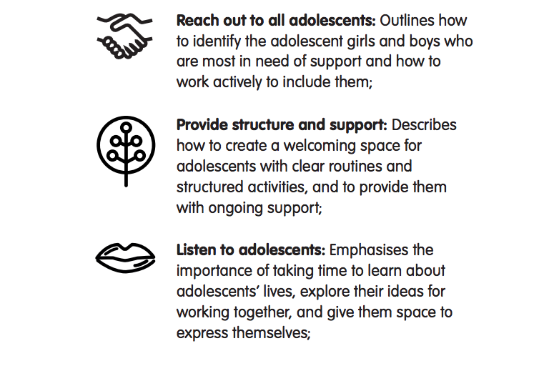
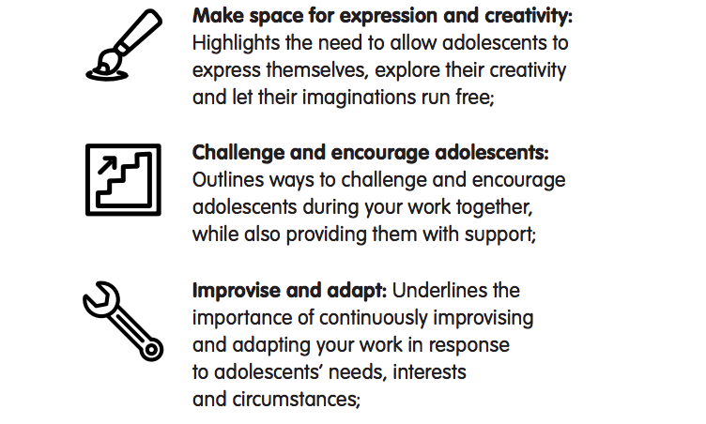
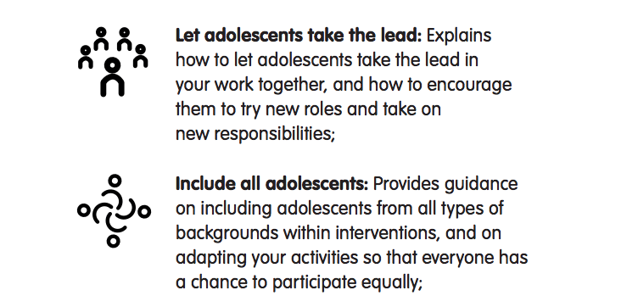
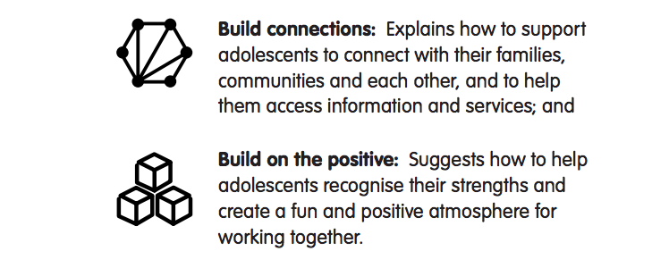
The Ten Key Approaches for working with and for adolescents
Notes:
Notes for the trainer:
Read this slide aloud and explain why each approach is important. Provide a few examples of how programme coordinators and/or facilitators can put each approach into practice.
Participants should review Foundation Guidance, The Ten Key Approaches as you give your explanation.
Ref: Foundation Guidance, The Ten Key Approaches

Slide 24
Key understandings:
Using Ten Key Approaches is essential to supporting adolescents in developing and using the Ten Key Competencies.
If facilitators, programme coordinators, and everyone else working with and for adolescents put these approaches into practice, our programmes are most likely to be effective in supporting adolescents’ development and use of the ten Key Competencies.
These Ten Key Approaches reflect UNICEF’s core principles and standards.
Using these Ten Key Approaches almost always requires doing some things differently from our usual ways. It requires that we take time for practice and support each other.
How we work with and for adolescents is fundamental to what we achieve with and for adolescents.
Notes:
Notes for the trainer:
Focus on the possibility that these approaches contribute to positive outcomes for adolescents, but note that if the approaches are not used, programmes and interventions are not likely to result in adolescents’ development and use of the ten competencies.
Ref: Foundation Guidance, The Ten Key Approaches

Slide 25
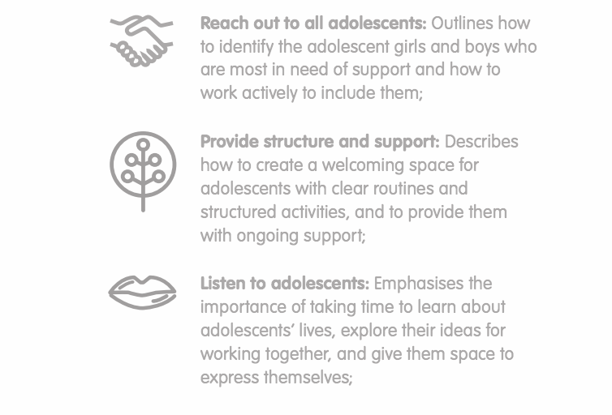
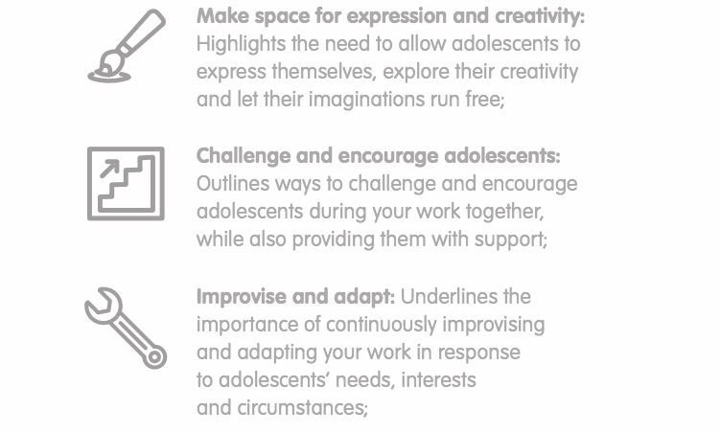
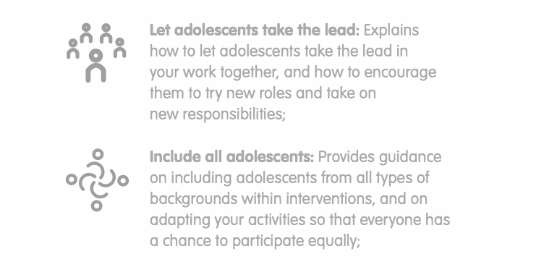
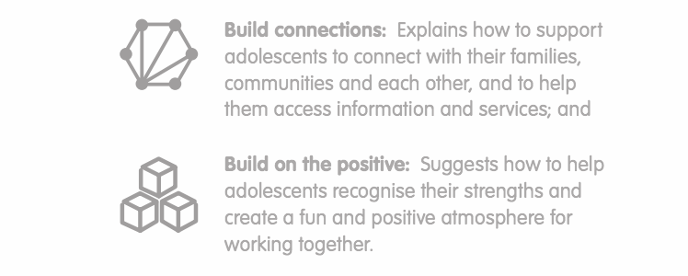
Group Work:
Focus on one of the Ten Key Approaches. Write a list of “do’s” and “don’ts” for how facilitators should put this approach into practice.
Do’s: When using this approach, facilitators should always…
Don’t’s: When using this approach facilitators should never…
Notes:
Notes for trainer:
Divide workshop participants into approximately ten small groups, and assign each group one of the Ten Key Competencies. (If there are not enough participants in the workshop for ten small groups, divide them into five groups and assign each group two of the competencies.)
Review workshop participants’ responses to the discussion questions to assess whether they understand each of the ten Key Approaches, and have suggested relevant and appropriate ways that facilitators can put those approaches into action.
Ref: Foundation Guidance, The Ten Key Approaches

Slide 26
Group Work (continued):
Matching ‘dos and ‘don’ts with the right ’approach’
Write each of your ‘do’s and don’ts’ on a separate card.
Place the ‘do’ or ‘don’t’ next to the approach for which it is most relevant.
Review discussion: Are there any ‘do’s’ or ’don’t’s’ that would be better placed with another of the ten Key Approaches?
Notes:
Notes for trainer:
Use this activity as an optional follow-up to the previous step if workshop participants still need more clarification to understand each of the ten Key Approaches.
Write each of the ten Key Approaches on a piece of paper, and put each on a different table or place on the floor around the training room. Then follow the steps as indicated on the slide.
When workshop participants reach step 2, they should place each card on the table or floor near the approach they intended it to reflect.
(If you find that there ’dos’ and ’don’ts’ that reflect important ways that adolescents should be treated, but are not specifically relevant for facilitators in their role, place these in a separate pile.)
Ask participants to walk around the training space and review which ‘do’s’ and ’don’t’s’ have been placed to correspond with each of the ten Key Approaches.
Invite participants to suggest changes so that the ‘do’s’ and ‘don’t’s’ are placed to correspond with an approach that is more relevant or appropriate.

Slide 27
Thank you!

